Slide 1

World Happiness Predictors!
Team Happy ☺
Safaa, Christa, Joe, Raphael, Kristen

Slide 2
Outline
Research Questions
Data Sources
Methodology
Results

Slide 3
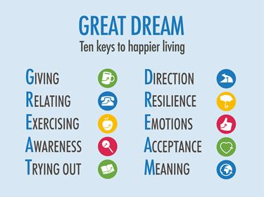
Research Questions
Can we predict country level happiness ?
Which data sources provide better predictions: Survey data, Social Media, or News articles?
Which models are better at predicting happiness?
Notes:
http://www.actionforhappiness.org/10-keys-to-happier-living

Slide 4
Data Sources
Survey Data (150 observations)
  World Happiness Survey Report– World Gallup Poll (2017)
  Corruption Perceptions Index – Transparency International (2017)
Notes:
1. World Happiness Survey:
The scores are based on answers to the main life evaluation question asked in the poll (Cantril ladder)
The weighted scores are from nationally representative samples for the years 2015-2017
Six factors – economic production, social support, life expectancy, freedom, absence of corruption, and generosity. They have no impact on the total score reported for each country, but they do explain why some countries rank higher than others
Dystopia, a hypothetical country that has values equal to the world’s lowest national averages for each of the six factors.
GDP per Capita, Family, Life Expectancy, Freedom, Generosity, Trust Government Corruption describe the extent to which these factors contribute in evaluating the happiness in each country
2. Corruption Perceptions Index:
The CPI draws upon a number of available sources which capture perceptions of
corruption. Each source is evaluated against the criteria listed below. Contact has
been made with each institution providing data in order to verify the methodology
used to generate scores and for permission to publish the rescaled scores from each
source, alongside the composite index score.
Reliable data collection and methodology from a credible institution
Data addresses corruption in the public sector: The question or analysis
Quantitative granularity
Cross country comparability
Multi year data-set
Data is then standardized and aggregated

Slide 5
Data Sources
Twitter (1533 observations)
  Tweets from 2017 ranking of :
    Top two happy countries (Norway and Denmark)
    Bottom two unhappy countries (Burundi and Central African Republic)
  Tweets from week of April 16th, 2018
  Dataset 1: No hashtags used
  Dataset 2: Hashtags used (# happy, family, trust, corruption, freedom, generosity)

Slide 6
Data Sources
New York Times country specific pages – 2017 news articles
  Dataset 1
    11370 observations
    Top two happy countries: Norway, Denmark & Bottom two unhappy countries: Burundi, Central African Republic
  Dataset 2
    700 observations
    A random systematic sample of 14 countries across the range of happiness score

Slide 7
Methodology
APIs: Tweepy and New York Times
Jupyter Notebook: Data management, visualization, sentiment analysis, machine learning and big data analysis
Tableau: Exploratory visualization
Models: Multiple Linear Regression, Artificial Neural Networks, Natural Language Processing

Slide 8
Data Management
Reading and merging Happiness and Corruption data into dataframes for regression and artificial neural network prediction models
Extracting tweets by location and creating a sentiment analysis by country
Extracting news article from a sample of countries and preparing them for NLP analysis

Slide 9
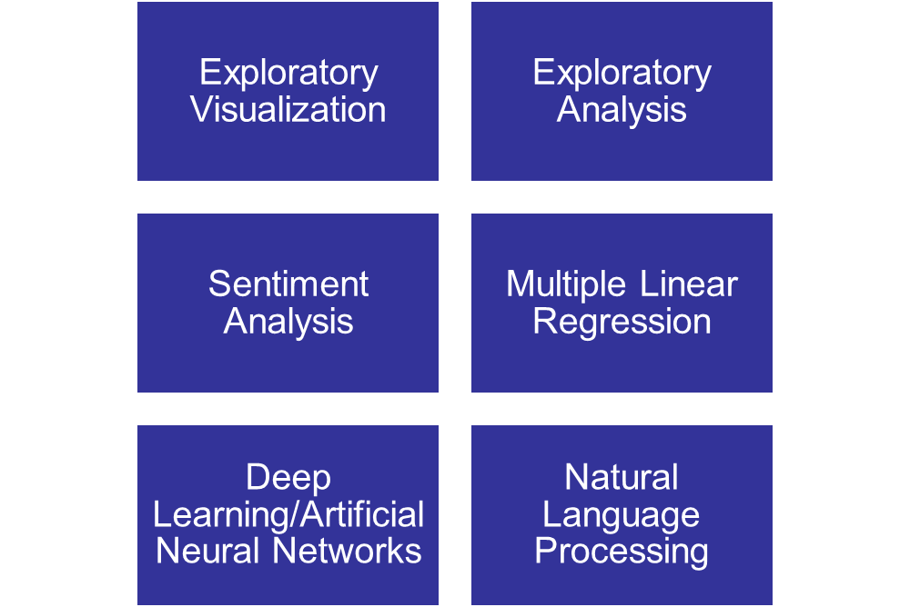
Machine Learning & Big Data
Analysis

Slide 10
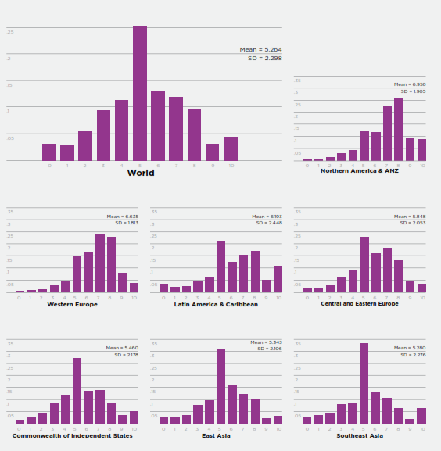
Summary Snapshot

Slide 11
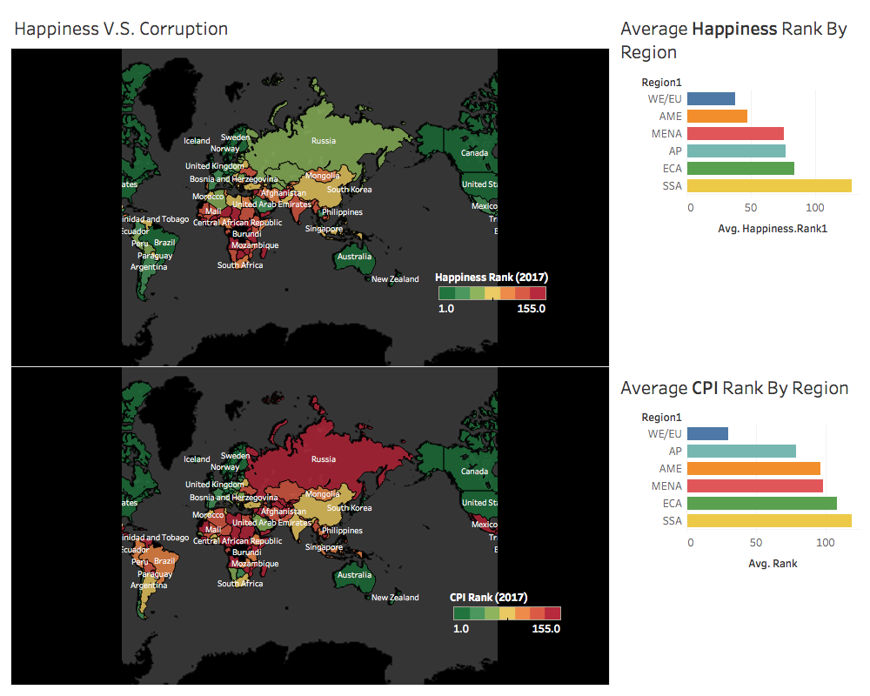
Data Visualization
Mapping Spatial Distribution
Happiness & Corruption Perceptions

Slide 12
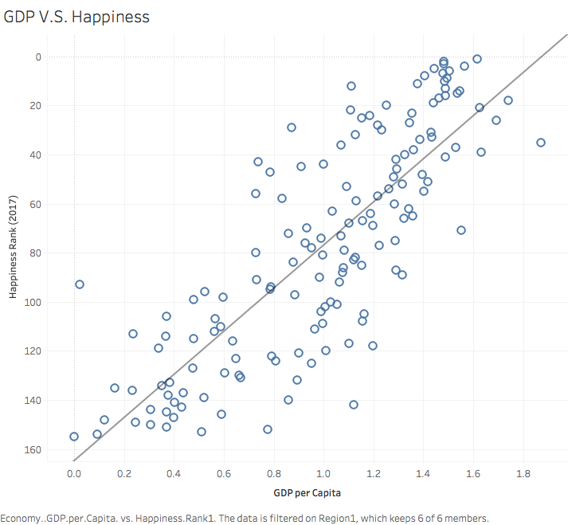
Data Visualization
Scatter Plots
Happiness Rank & GDP
Can money buy happiness?!!

Slide 13
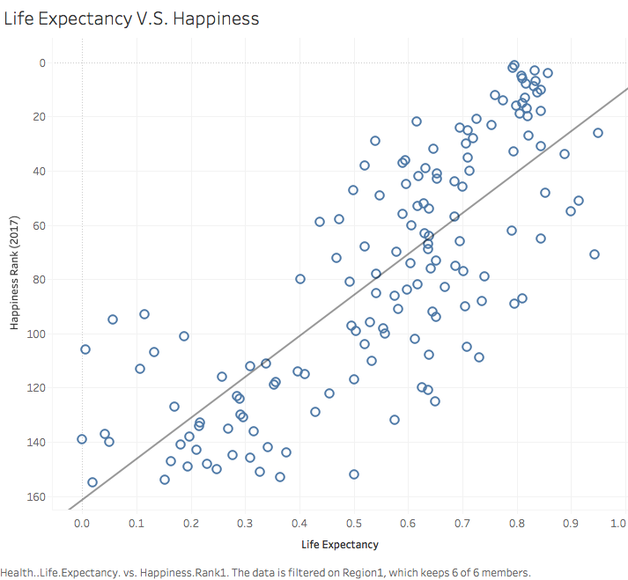
Data Visualization
Scatter Plots
Happiness Rank & Life Expectancy
Is a longer life a happier life?!

Slide 14
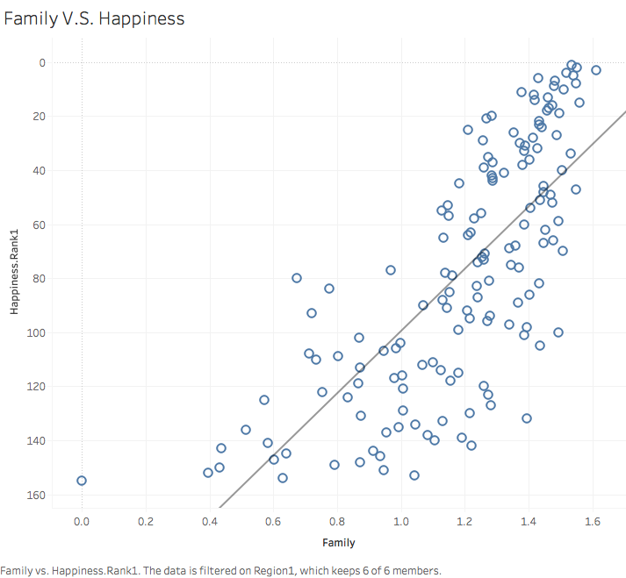
Data Visualization
Scatter Plots
Happiness Rank & Family
Does Family and Social Support lead to a happier life?

Slide 15
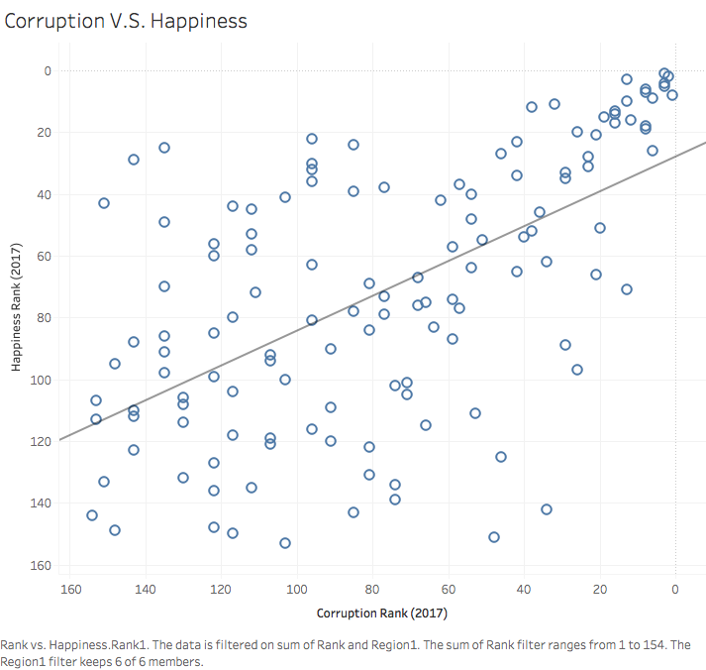
Data Visualization
Scatter Plots
Happiness Rank & Corruption
Are more corrupt countries more miserable?

Slide 16
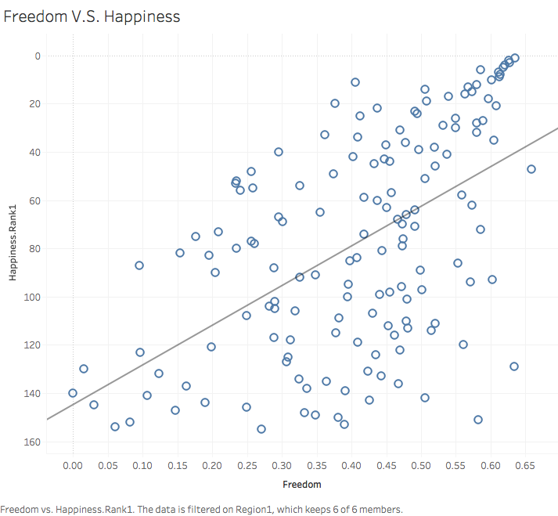
Data Visualization
Scatter Plots
Happiness Rank & Freedom
Is people’s sense of freedom leading to happiness?

Slide 17
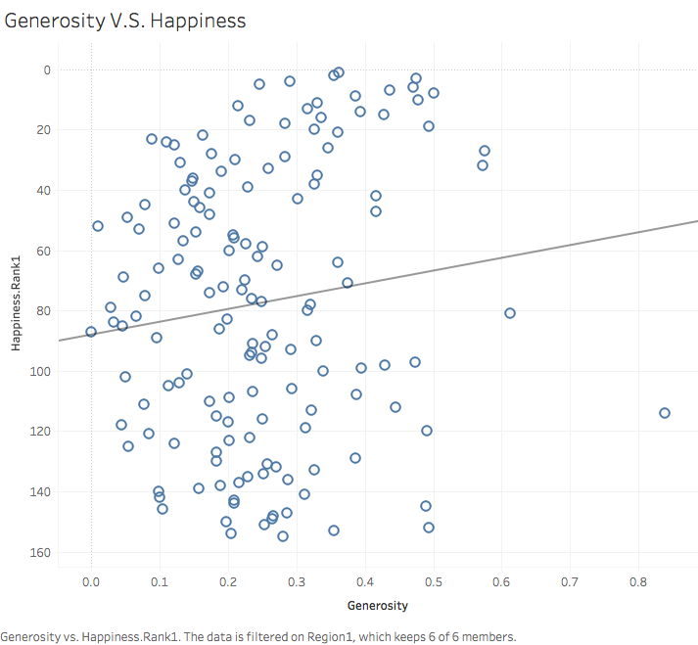
Data Visualization
Scatter Plots
Happiness Rank & Generosity
Are generous populations happier?

Slide 18
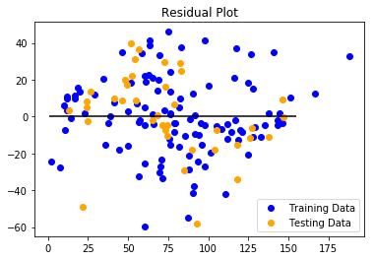
Analysis
Exploratory
Can we Confidently predict happiness ranking using columns from happiness data?
Training Score: 0.7795
Testing Score: 0.7902
MSE: 454.65
R2: 0.79
Notes:
Using 2017 data
Predicting Y= happiness rank
Covariates (Xs) are GDP, family, Life expectancy, freedom, generosity, and trust

Slide 19
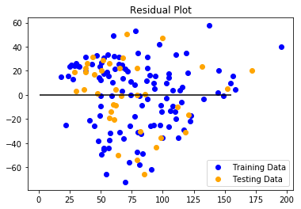
Analysis
Exploratory
Will our predictions (training score) improve when we factor in CPI data?
Training Score: 0.7807
Testing Score: 0.7862
MSE: 463.26
R2: 0.78
Notes:
Using 2017 data
Predicting Y= happiness rank
Covariates (Xs) are GDP, family, Life expectancy, freedom, generosity, and trust
Adding CPI as a covariate to the model

Slide 20
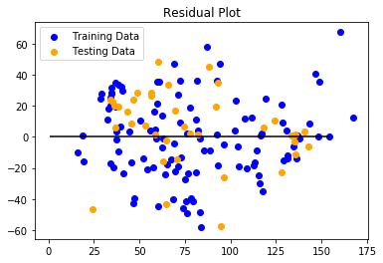
Analysis
Exploratory
Social Values
Quantitative Values
Training Score 0.5940
Testing Score: 0.6462
MSE: 766.77
R2: 0.6462
Training Score: 0.6763
Testing Score: 0.7326
MSE: 579.47
R2: 0.73
Notes:
Using 2017 data
Predicting Y= happiness rank
X1 vector = Social values (Family, Freedom, Generosity)
X2 vector = Quantitative Values (GDP & Life Expectancy)?

Slide 21
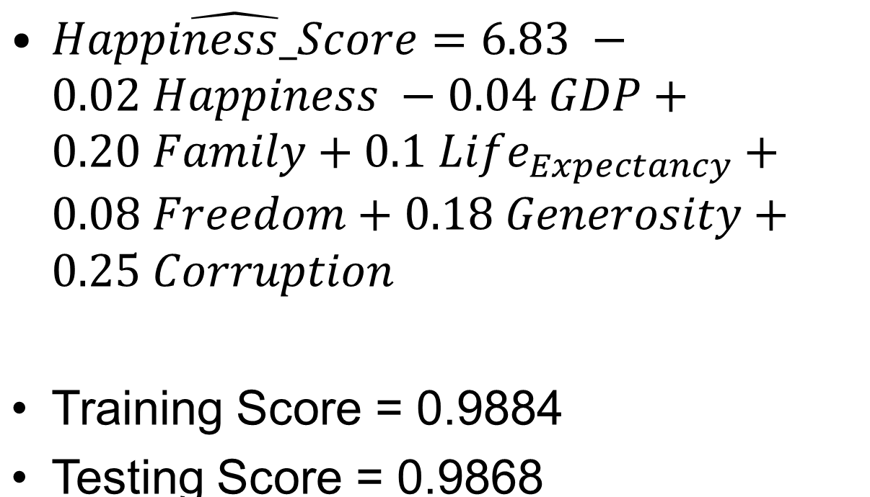
Analysis
Multiple Linear Regression
MSE = 0.0153
Notes:
2017 data
Y is the happiness score not the rank
X is all covariates/predictors

Slide 22
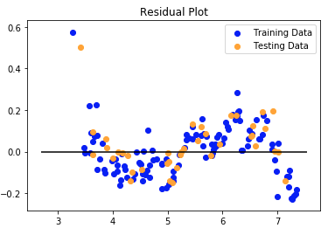
Analysis
Multiple Linear Regression
Notes:
Curvilinear trend not detected by Multiple Linear Regression
Two potential outliers

Slide 23
Analysis
Artificial Neural Networks
Built an ANN for regression prediction
  150 epoch to converge
  MSE 0.3087
  MAE 0.3993
  MAPE 8.1614
A network with two hidden layers
Layer | Nodes | Activation function
Input | 7 | N/A
Hidden 1 | 20 | relu
Hidden 2 | 12 | relu
Output | 1 | Linear
Notes:
MSE = Mean square error
MAE = Mean Absolute Error
MAPE = Mean Absolute Percentage Error

Slide 24
Analysis
Sentiment Analysis
General API data extract across the top two and bottom two countries in happiness ranking from 2017
Country | Compound | Negative | Neutral | Positive
Denmark | 0.057952 | 0.91811 | 0.02392 | 0.05796
Norway | 0.035651 | 0.89549 | 0.03643 | 0.06810
Burundi | -0.129589 | 0.90068 | 0.08475 | 0.01457
CAR | 0.018471 | 0.84052 | 0.07067 | 0.0880
Notes:
English tweets
No hashtags
Sentiment analysis results: compound sentiment is lower for unhappy countries compared to happy countries but trends are not clear for negative, neutral, or positive
Tweets reflect the last week so only reflect a very brief snapshot and is based on a different timeframe compared to other data sources➔ Thus less reliable in predicting happiness

Slide 25
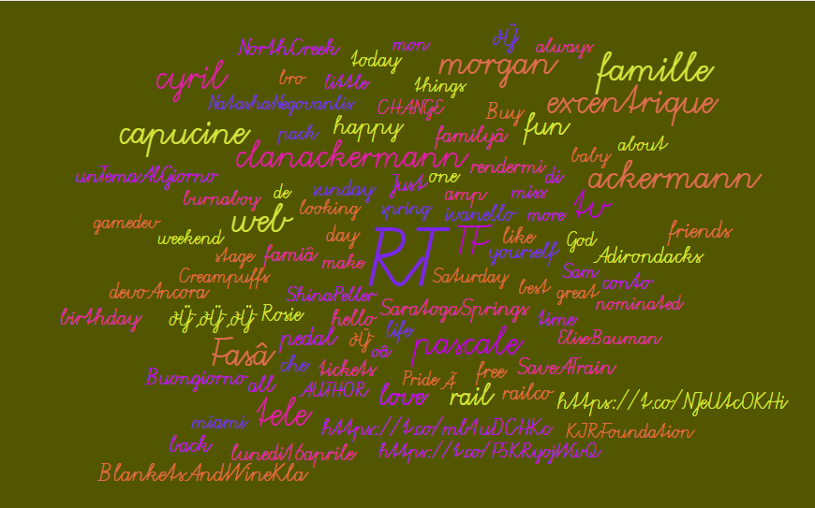
Analysis - Tweets
Word Cloud
Notes:
https://worditout.com/word-cloud/create
Tweets with Hashtags

Slide 26
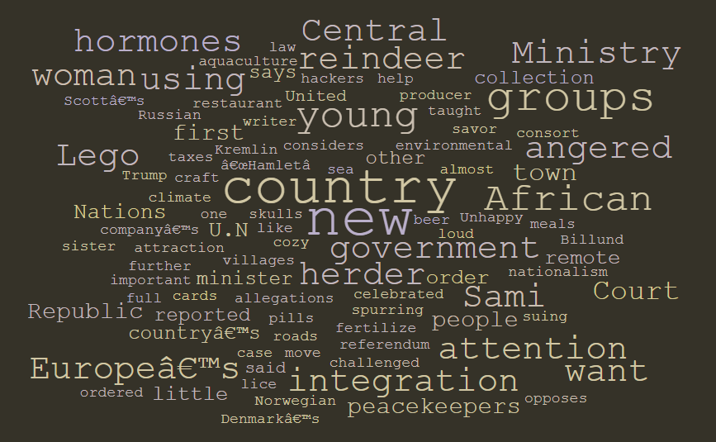
Analysis – New York Times
Natural Language Processing
Word Cloud
Notes:
https://worditout.com/word-cloud/create
Top 2 and bottom 2 countries
Model Accuracy of 1
Prediction for Iceland ➔ Accuracy is 100%

Slide 27
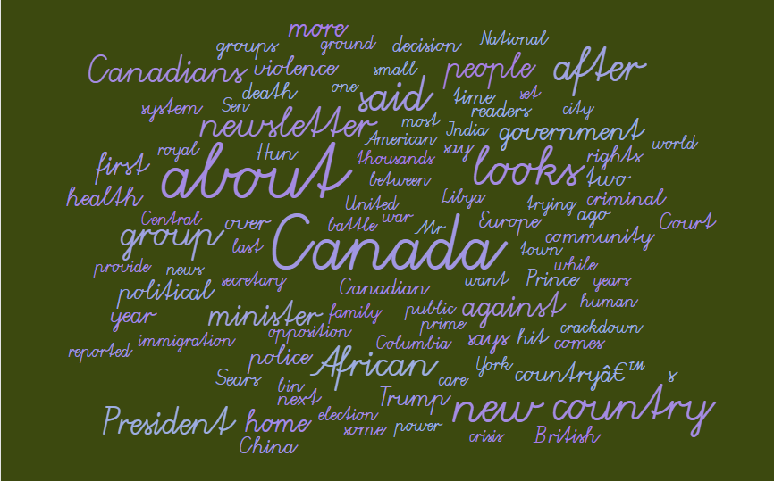
Analysis – New York Times
Natural Language Processing
Word Cloud
Notes:
With a systematic sample of 14 countries across happiness
50 articles per country
Accuracy of the model 0.9863
Prediction for Iceland ➔ 100%

Slide 28
Results Summary
Sentiment Analysis – Worst performance ➔ does not differentiate between happy and unhappy countries
Exploratory Analysis and Visualization main predictors of Happiness are: Corruption, Freedom, Family, and GDP
Natural Language Processing yielded high accuracy models but model is harder to interpret with large number of articles

Slide 29
Results Summary
MLR
ANN
Model with R-squared of 98%
MSE of 0.0153
Relationship between Happiness score and Covariates can be interpreted
Curvilinear outliers
MSE of 0.3087
Harder to identify or interpret relationship between happiness and input variables

Slide 30
Thank you!

